Slide 1

Canvas HUD Interface Subsystem
Open Source: Flight Simulator
SOFTWARE ENGINEERING LAB (16CS54)
KSHITIJ TIWARI 1RV16CS075
KESHAV BHARAT 1RV16CS070

Slide 2
INTRODUCTION
AIM
FUNCTIONAL REQUIREMENTS
NON-FUNCTIONAL REQUIREMENTS
DESIGN AND IMPLEMENTATION
RESULTS
TESTING
CONCLUSION
Contents
Flight gear

Slide 3

Introduction
The aim of the FlightGear project is to create a sophisticated and open flight simulator framework for use in research or academic environments, pilot training, as an industry engineering tool, for DIY-ers to pursue their favorite interesting flight simulation idea, and last but certainly not least as a fun, realistic, and challenging desktop flight simulator.

Slide 4

What Are We Doing?
Given the legacy existing software, there is considerable lag in frame rates due to garbage collection occurring during runtime. Further, it is desirable to improve the 3d rendering capabilities of the existing software.
The HUD in the aircraft is currently displayed by means of raw OpenGL calls. We aim to replace these with commands issued from a custom API.
This will make it much easier for other developers to add features and work on improving the efficiency of the rendering.
It will also increase the portability of the HUD, i.e., lesser chances of artefacts getting generated.

Slide 5
Functional Requirements
End Users:
Git based versioning
Given that the user has cloned official repository using git, the system should git based versioning to ensure that the user can easily update to the latest versions.
Screen Tearing Control
Given that the application has been installed, and the displays support synchronization such as freesync or gsync, support for these techniques should be available to the user.
Joystick Support
The system should provide user with facility to calibrate a joystick to provide inputs to the aircraft. Post calibration, the user will be able to view changes in the HUD corresponding to joystick position.
Developers
Abstract OpenGL
The system should provide the developer with an abstraction of OpenGL. The API calls alone must be required for rendering the HUD.
Git Based Versioning
Given that the developer has made a change to the rendering code, and given that it is approved, the system must allow for changes to be pushed via git versioning system.

Slide 6
Non-Functional Requirements
Performance Requirements
In the Nasal scripting language, memory is not manually allocated and freed, rather it is handled by the VM using Garbage collection. We require that the framerate is affected minimally by the Garbage Collector under heavy loads, such as complex scripts.
Security Requirements
The system has a capability for online DNS based multiplayer mode. This consists of several clients connecting to a single server. It is desirable to ensure end to end security in each communication channel from the channel to the server. This can be implemented by introducing an encryption scheme at each end.

Slide 7
TOOLS USED
Git
Draw.io
Windows SDK
Visual Studio
Nasal Console
CMake
SOFTWARES AND MODULES USED
Canvas
C++
Nasal
openGL
openAL
plib
Design & Implementation
Flight Gear

Slide 8

Design & Implementation
Iterative and Incremental Development
Agile process
Prototyping
Risk Assessment and Control
Manual Testing
Integration Testing

Slide 9
Design & Implementation
We use the agile model for development. After each iteration we review the code with the flight gear developers. Coding is done using pair programming to increase the throughput.
We have 3 main iterations.
Iteration 1 In this iteration we decide on the layout of the HUD. The components to be adapted (and those to be ignored initially) are determined and a basic design is generated using SVG.
Iteration 2 This iteration involves the coding of the inanimate objects (such as baselines, and value displays).
Iteration 3 The final iteration involves determining the scaling and the movement of the animate objects (such as pointers, indicators, elevation line movements).

Slide 10
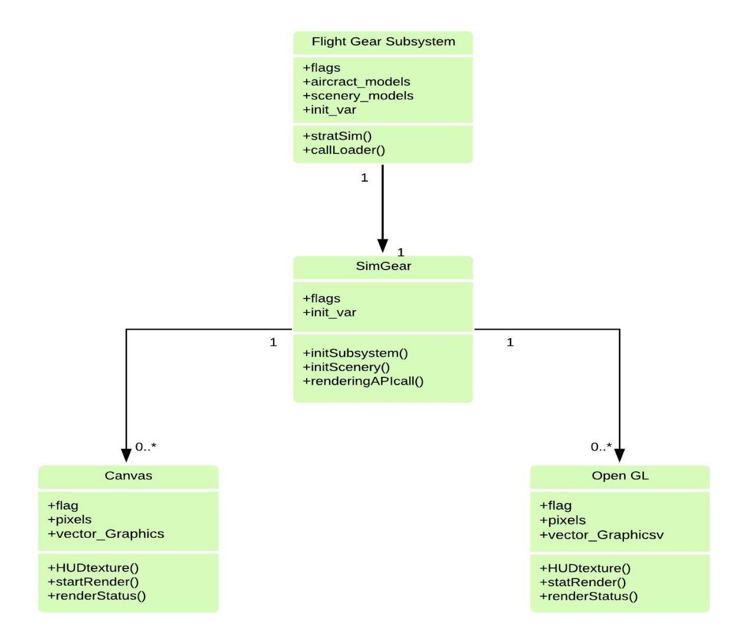
Design & Implementation
Class Diagram of Flight Gear

Slide 11
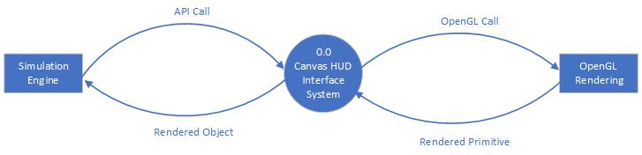
Design & Implementation
DFD Level 0 of Flight Gear
Notes:
Download more minimal templates here: https://crmrkt.com/GK9Dwa

Slide 12
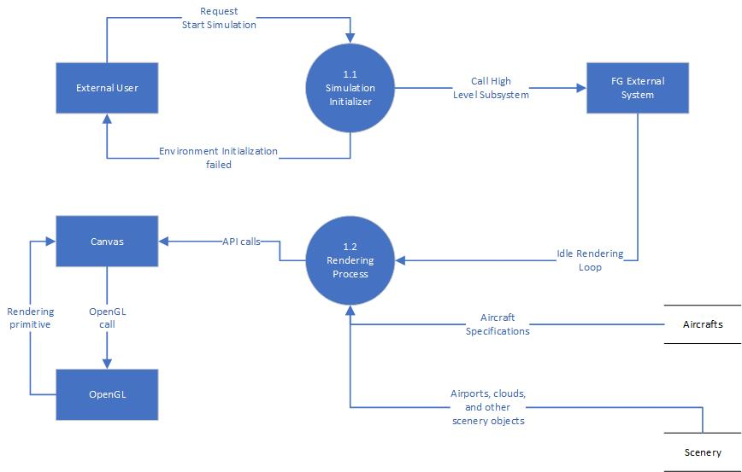
Design & Implementation
DFD Level 1 of Flight Gear
Notes:
Download more minimal templates here: https://crmrkt.com/GK9Dwa

Slide 13
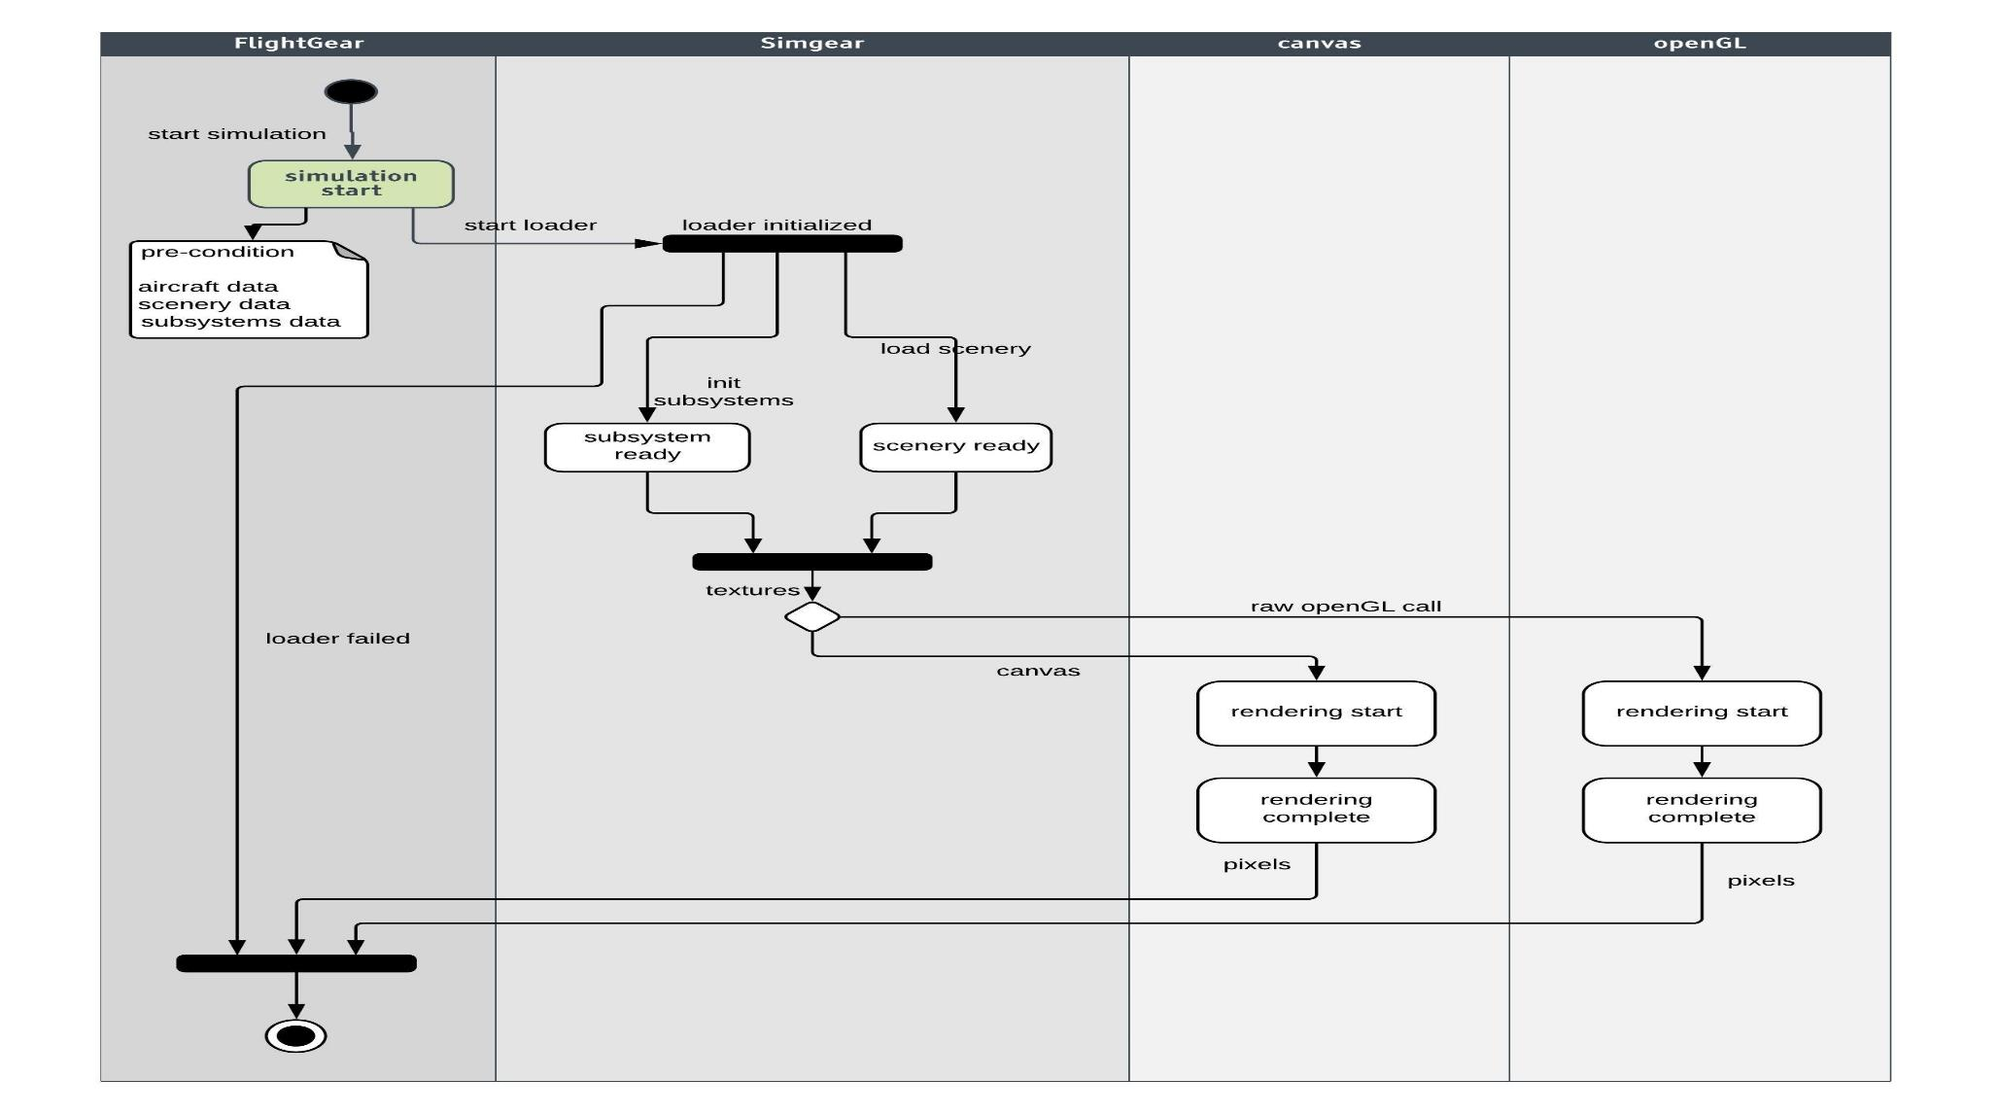
Design & Implementation
Activity Diagram of Flight Gear

Slide 14
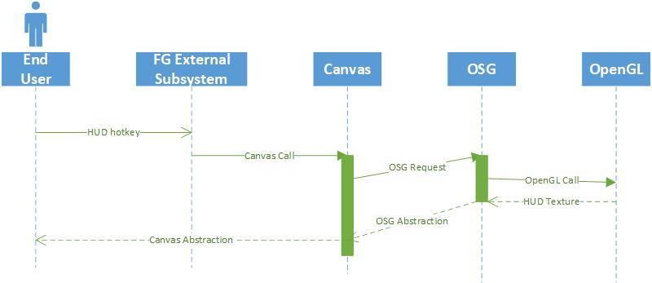
Design & Implementation
Sequence Diagram of Flight Gear

Slide 15
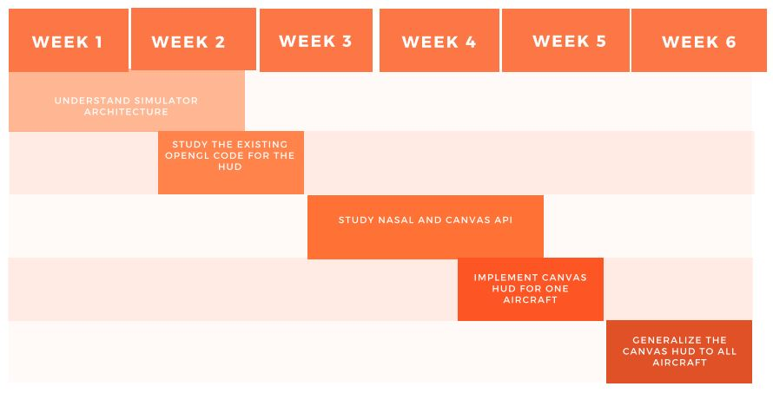
Design & Implementation
Timeline of the project

Slide 16
Testing
Black Box Testing This testing is done to ascertain if the functional requirements are being met. The implementation and other internal details are not considered here. 1. Elevation Testing This involves elevating the aircraft by pulling the control back and validating if the aircraft elevation is correctly displayed. Testing is done from 0 to 90, and -90 degrees, and the system passes the test case. 2. Pitch Testing The aircraft is pitched by adjusting the ailerons. The observed roll angle between the water line and the elevation lines should be equal to the measured angle of roll. Testing is done from 0 to 180 clockwise, and 0 to 180 anticlockwise. The system passes the test case.

Slide 17
Testing
3. Yaw Testing The aircraft is turned using the radar. The horizontal displacement of the waterline should be equal to the horizontal displacement of the heading. Testing is done from -90 to 90 and the system passes the test case. 4. Thrust Testing This involves increasing thrust to the engines and checking if the change is reflected on the HUD. Thrusters are tested from idle to maximum. System failed the test case as the updation wasn’t done correctly. It is fixed by altering the scale factor of the thrust tape.

Slide 18
Testing
White Box Testing This testing is done to ascertain if there are any security holes, poorly structured paths, etc. in the code. 1. Code coverage We noted that we had not checked the code for drawing the thrust tape, and there were repetitive drawing calls made for it. To fix it, we made the drawing iterative, at the cost of putting pressure on the garbage collector. 2. Performance Testing The performance is primarily judged by the delay in updation. The updation of the thrust was found to be slow. The cause

Slide 19
Testing
2. Performance Testing The performance is primarily judged by the delay in updation. The updation of the thrust was found to be slow. The cause was determined to be overhead of drawing calls resulting in recalculation of the scaling factor. This was fixed by predetermining the scale for a particular tape length and confining movement of the indicator within its length.

Slide 20
Results
Canvas based HUD is implemented for the Fokker 50 with PW125B, incorporating the following elements.
Base Line and Elevation Lines These indicate the zero degree elevation and the various other elevations in steps of 10.
Water Line This indicates the axial orientation of the aircraft, and helps in determining the pitch of the aircraft.
Water Line This indicates the axial orientation of the aircraft, and helps in determining the pitch of the aircraft (given by moving the ailerons).

Slide 21
Results
Yaw Indicator This indicates the yaw of the aircraft which determines the horizontal heading. It is primarily controlled by adjusting the rudders and ailerons
Thrust Level This indicates the amount of thrust supplied to the engines. It is controlled using the thrusters.
Air and Ground Speeds These give the air and ground speeds (in knots). The instruments are used to supply these values

Slide 22
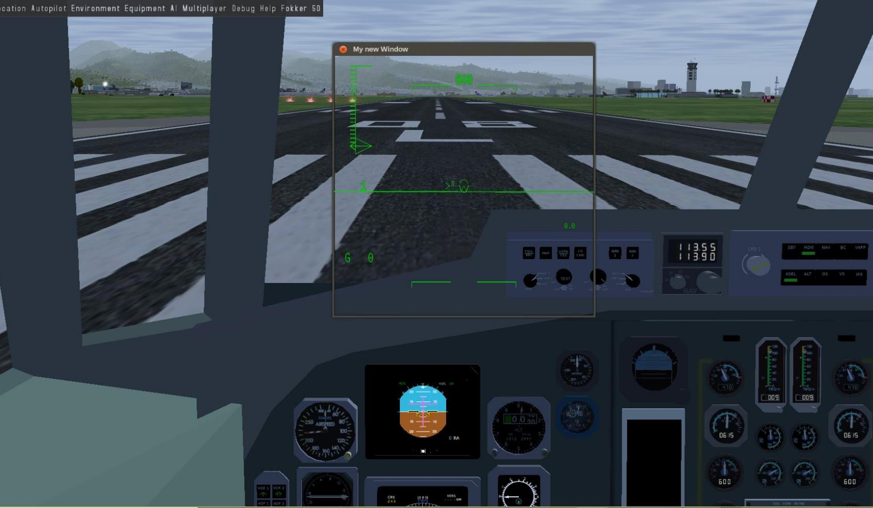
Results
Fig. 1: Plane is at rest on the runway

Slide 23
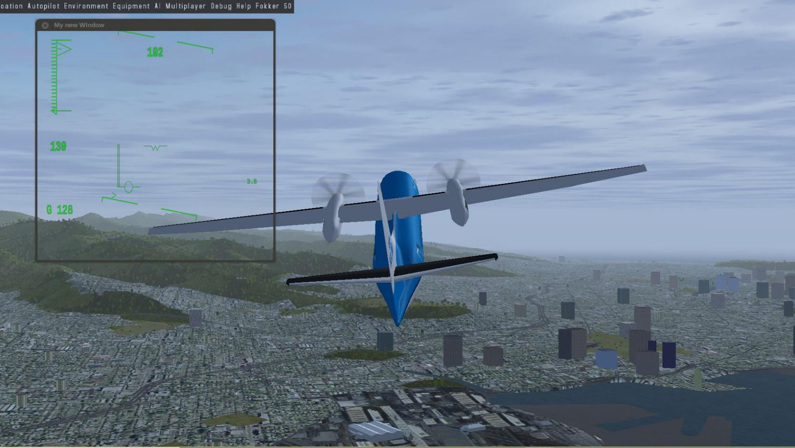
Results
Fig. 2: Plane in motion – attaining cruise altitude

Slide 24

Conclusion
Canvas API was found to be suitable for drawing the HUD.
The time taken to update the pitch and yaw from the property tree was found to be negligible.
There seems to be some delay in updating the value of the thrusters, probably due to the fact that the scaling factor is recalculated.
Elevation lines are found to be reasonably accurate.
Currently the values of minimum and maximum thrust values are being hardcoded from the engine datasheet. There is a need to integrate these values within the property tree to avoid rewriting the script for each aircraft.

